Slide 1






TYPES OF MACHINE LEARNING
DROPOUT PROGRAMMER

Slide 2

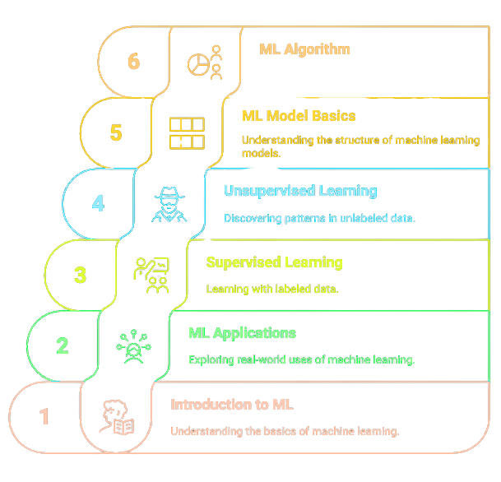

Slide 3




MACHINE LEARNING
Supervised Learning
Supervised Learning
Supervised Learning
SUPERVISED
LEARNING
UNSUPERVISED
LEARNING
REINFORCEMENT
LEARNING

Slide 4
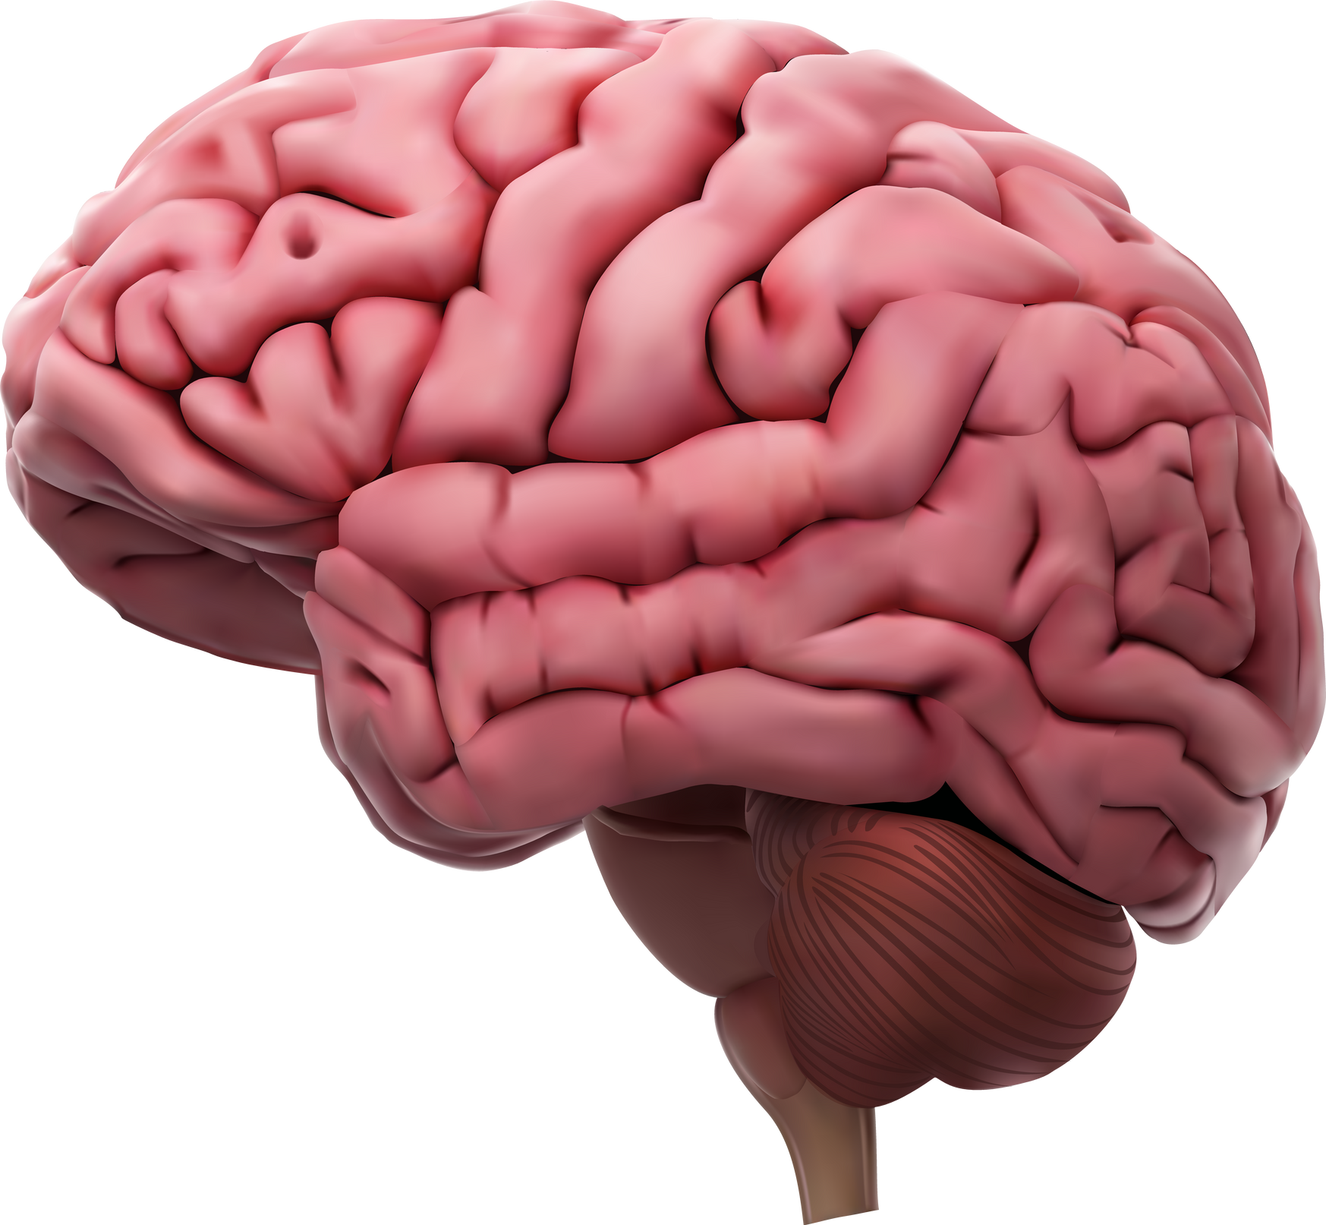


Supervised Learning
Supervised Learning
HUMAN BRAIN VS. MACHINE

Slide 5




Slide 6






Supervised Learning
ALGORITHM VS. MODEL
Algorithm
Model

Slide 7
MACHINE LEARNING
Supervised Learning
Supervised Learning
Supervised Learning
SUPERVISED
LEARNING
UNSUPERVISED
LEARNING
REINFORCEMENT
LEARNING

Slide 8
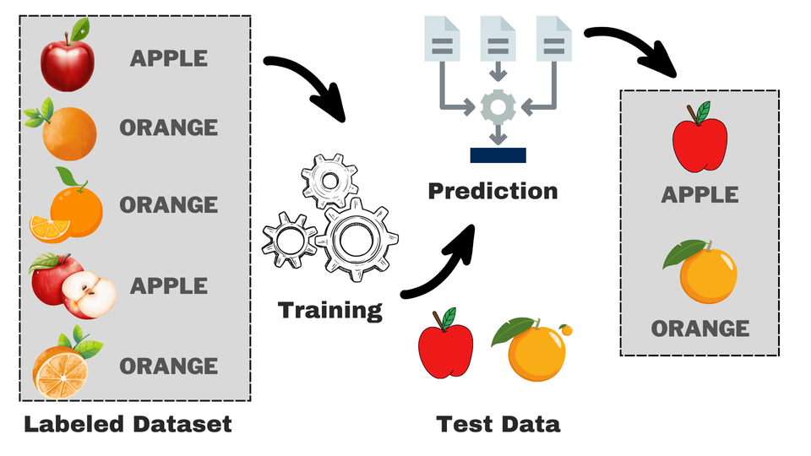
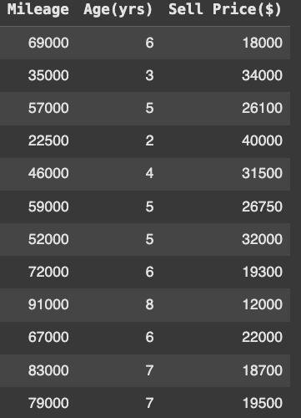
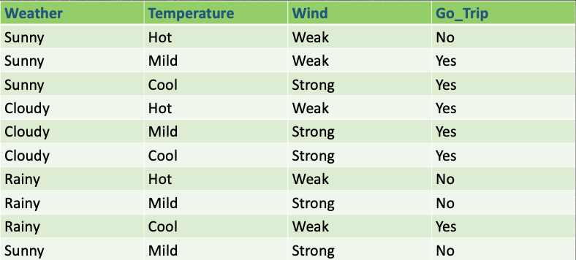
Supervised Learning
SUPERVISED
LEARNING

Slide 9
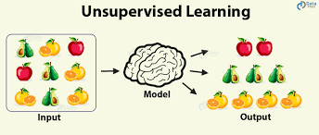
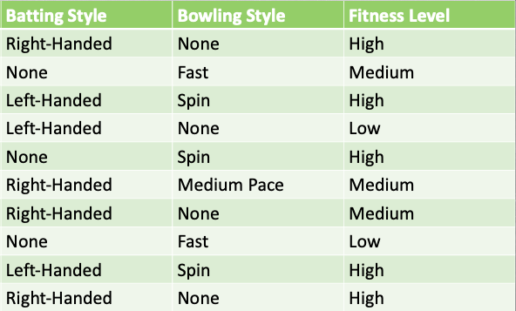
Supervised Learning
UNSUPERVISED
LEARNING

Slide 10
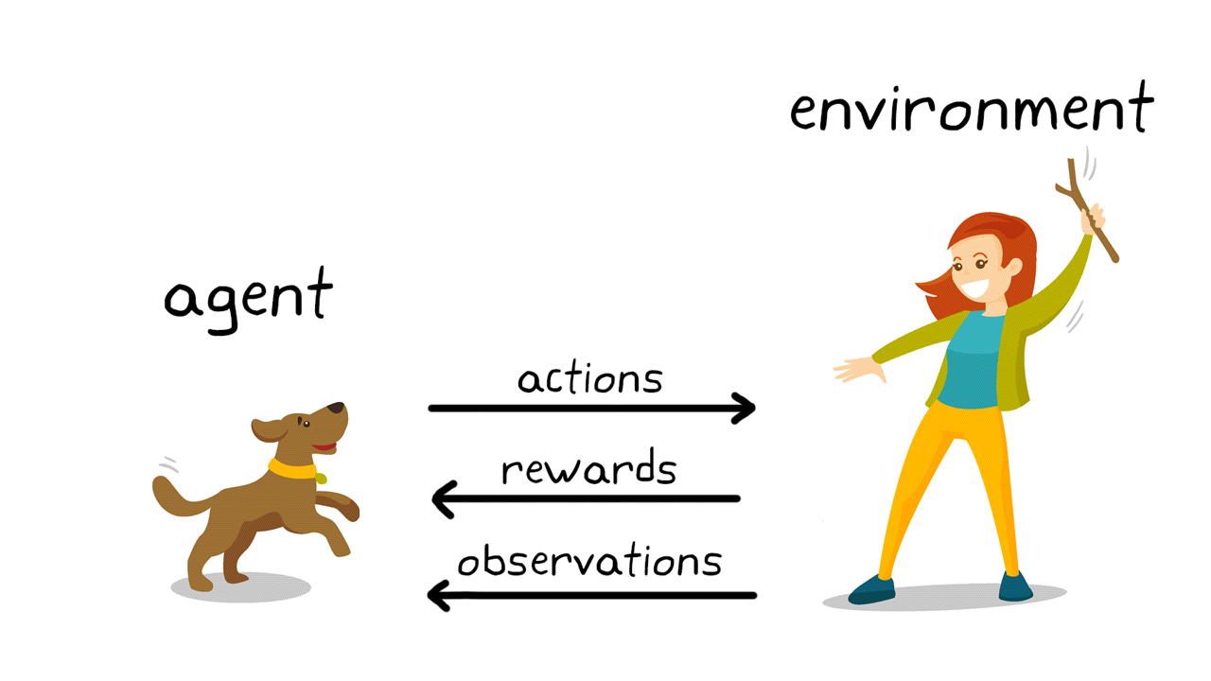
Supervised Learning
REINFORCEMENT
LEARNING

